Slide 1
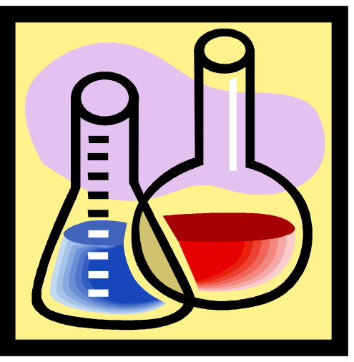
STATES OF MATTER
The Four States of Matter
Solid
Liquid
Gas
Plasma

Slide 2

Materials
Everything is made from some sort of ‘material’
Materials are made up of lots and lots of tiny pieces
These tiny pieces are known as particles
Solids, liquids and gases are all made of lots of particles

Slide 3

Solids
A solid is something that we can hold on to
A solid keeps its shape, unless we cut it or shape it ourselves
In a solid, all of the particles are packed together very tightly

Slide 4
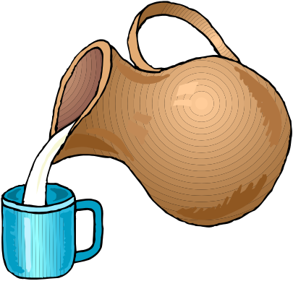
Liquids
They can be poured
The particles are less tightly packed, so they can move about
If poured from one container to another, they will take the shape of their new container

Slide 5

Gases
The particles in gases have lots of room to move
Gases are all around us
They spread into all of the empty places they can
Most are invisible

Slide 6
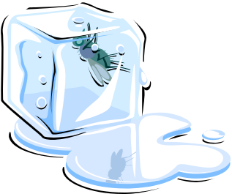
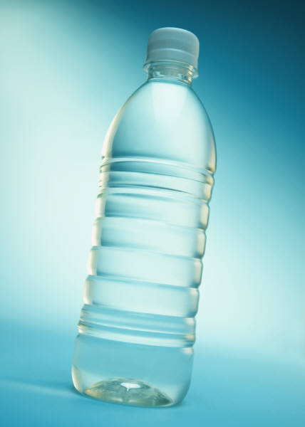
An example – water
Water can be a solid, a liquid or a gas.
When it is cold it is solid – ICE
When it is at room temperature it is a liquid – WATER
When it is hot it is a gas – STEAM

Slide 7
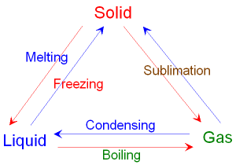
Phase Changes

Slide 8
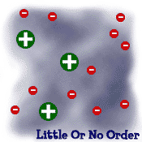
PLASMA
A plasma is an ionized gas.
Heating a gas may ionize its molecules or atoms, turning it into a plasma, which contains charged particles: positive ions and negative electrons or ions.
Like gas, plasma does not have a definite shape or a definite volume.

Slide 9
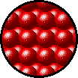
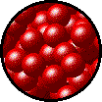
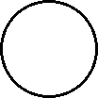
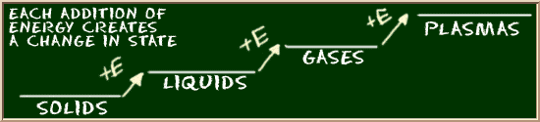
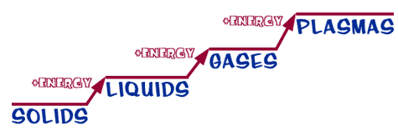
CHANGES OF STATES
SOLID
LIQUID
GAS
PLASMA
Tightly packed, in a regular pattern
Vibrate, but do not move from place to place
Close together with no regular arrangement.
Vibrate, move about, and slide past each other
Well separated with no regular arrangement.
Vibrate and move freely at high speeds
Has no definite volume or shape and is composed of electrical charged particles

Slide 10
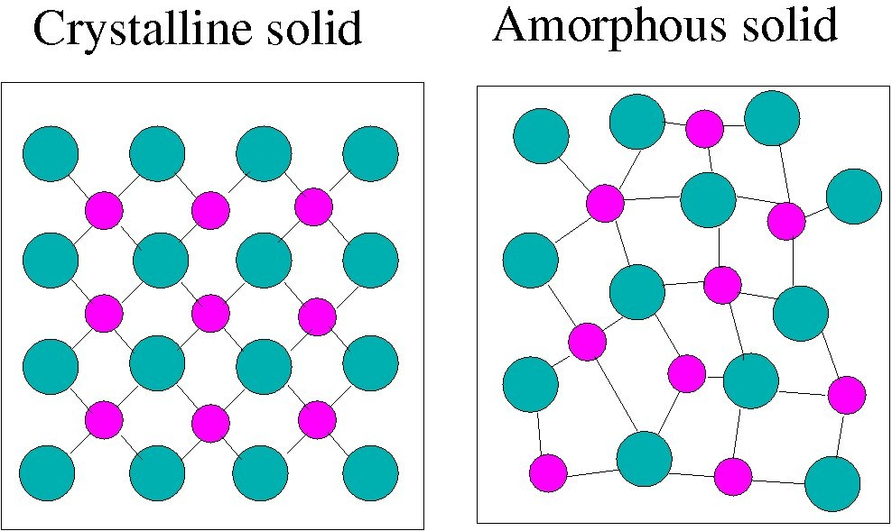
In general solids can be classified into two categories such as:
(i) Crystalline
(ii) Amorphous or Non- crystalline
Crystalline solid: In crystalline solid the atoms or molecules are arranged in a definite, repeating pattern. Constituent atoms or molecules are arranged in a regular manner and produced by the repetition of pattern unit. Examples: Salt and sugar.
Amorphous or Non-crystalline solid: In Non-crystalline solid the atoms or molecules do not repeat periodically. Examples: Plastic, rubber and glass.

Slide 11
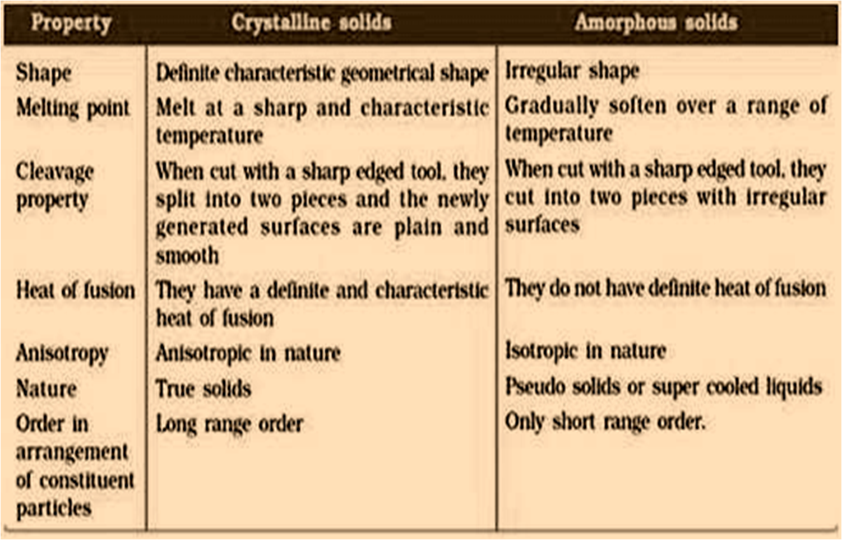
Differences between Crystalline & Amorphous solids:

Slide 12
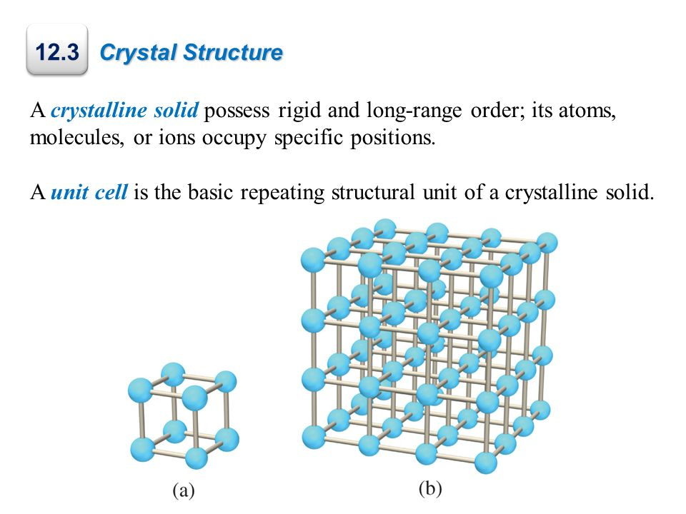
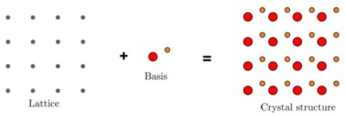
Some Definitions
Crystal: A crystal is a three dimensional regular and periodic arrangement of atoms. An ideal crystal is formed by the infinite regular repetition of identical structural units.
Lattice: It is a regular and periodic arrangement of points in space.

Slide 13
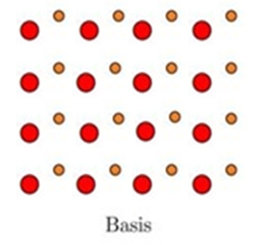
Basis: The structure of all crystal is described in terms of a lattice with a group of atoms attached to each lattice point. The number of atoms or molecules present at the lattice is called basis. It is repeated in space to form the crystal structure.
Crystal structure: It is formed when a basis is attached to lattice

Slide 14
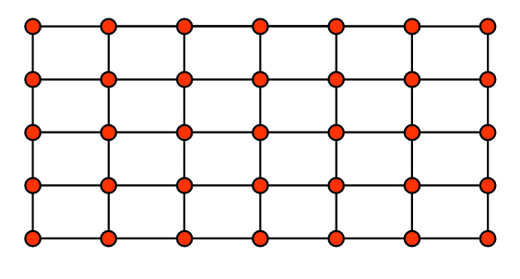
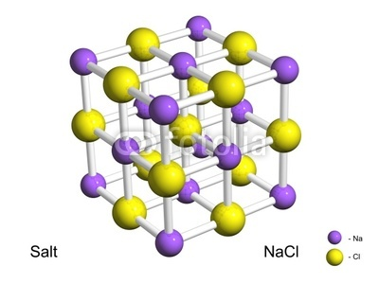
Plane lattice: If all the atoms are arranged in a plane, then it would be visible like below picture. In this way in two dimension plane all points will have same atomic surroundings.
Space lattice: If all the atoms are having similar surroundings in three dimensional spaces like the adjacent figure, then such type of atomic arrangement is called space lattice.

Slide 15
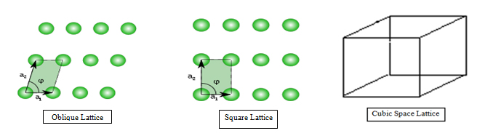
Bravais lattice: There are various ways of positioning points (lattice) in space such that all points have same identical surroundings, i.e. all points are of same kind and equivalent. These lattices are known as Bravais lattices. Bravais showed that, there exist no more than 14 space lattices in three dimensions. In order to specify the arrangements of points in a space lattice, he introduced 7-system of axes or crystal system.
Non-Bravais lattice: All points are not identical compared to each other known as non-Bravais lattices.

Slide 16
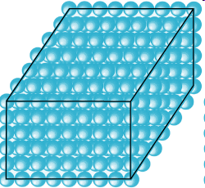
Types of Crystalline Materials
Single Crystalline materials
Polycrystalline materials
Single Crystal: It is a material in which the crystal lattice is continuous and unbroken to the edges of the sample, with no grain boundaries. When periodicity of the pattern stretch out to many cubic cm in volume is called single crystal. A homogenous solid formed by a repeating, three-dimensional pattern of atoms, ions, or molecules are having fixed distances between constituent parts. The unit cell is of such a pattern. Example: Diamond.

Slide 17
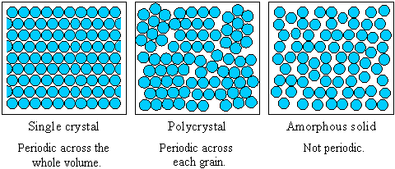
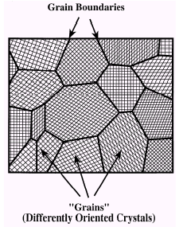
Polycrystal: Polycrystalline materials are composed of a number of smaller crystals. Most of the crystalline solids are made up of millions of tiny crystals called grains and are called to be polycrystalline.
In polycrystalline crystals the periodicity does not extend throughout the crystal but is interrupted at grain boundaries.
Polycrystalline is the structure of a solid material that forms crystallite grains at different points within it. The areas where these crystallite grains meet are known as grain boundaries.

Slide 18

Physics is hopefully simple but Physicists are not

